Slide 1
Lesson 1: Fundamentals of Programming
Fe Maidens Programming 2017-2018
Welcome Everyone!

Slide 2

What is Programming?
When you write code, you tell a computer what to do. Those directions are then carried out by the computer, and create action. Code is written in different languages, or different ways for humans to interface with computers.

Slide 3
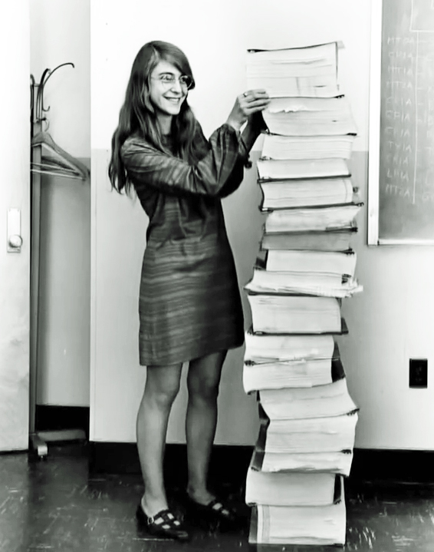
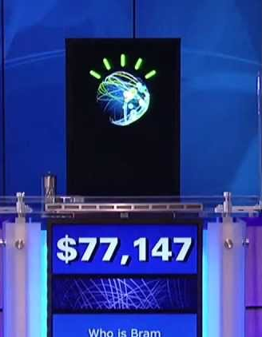
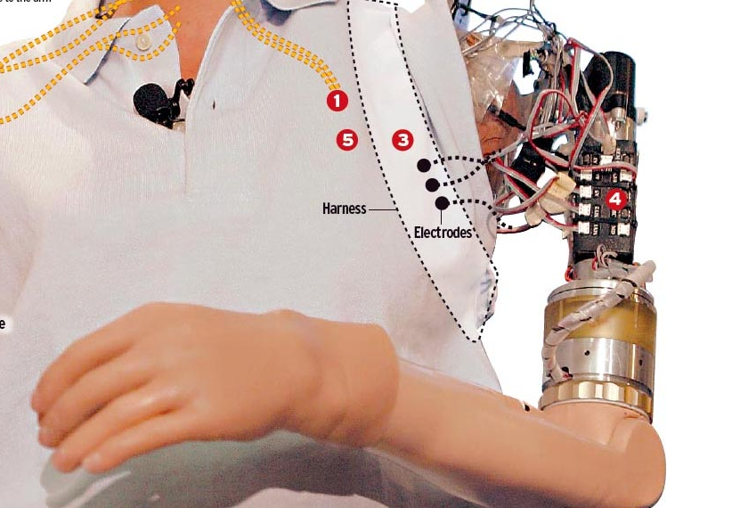
How is programming used?
Programming is used almost everywhere, from the business world to science and beyond. Here are some examples:
Programming has been used to create prosthetics controlled by the mind of a wearer
This is Margaret Hamilton. Her code got people on the moon!
IBM’s Watson, an Artificial Intelligence, recently won Jeopardy

Slide 4
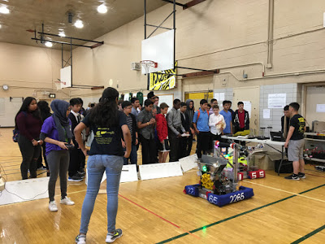
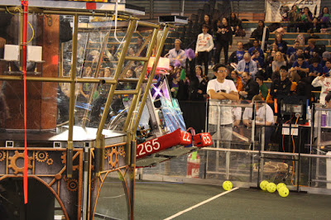
How does the FeMaidens use programming?
Programming is what gives the brain to the physical robot. Using the Java language, as well as libraries provided by FIRST, we are able to write code that makes different parts of the robot perform different actions. For example, we can code our robot to drive autonomously by programming 4 motors, or connect these motors to input from controllers.
This picture shows the robot we built last year. Using code, we were able to climb, score gears, and of course, drive!

Slide 5
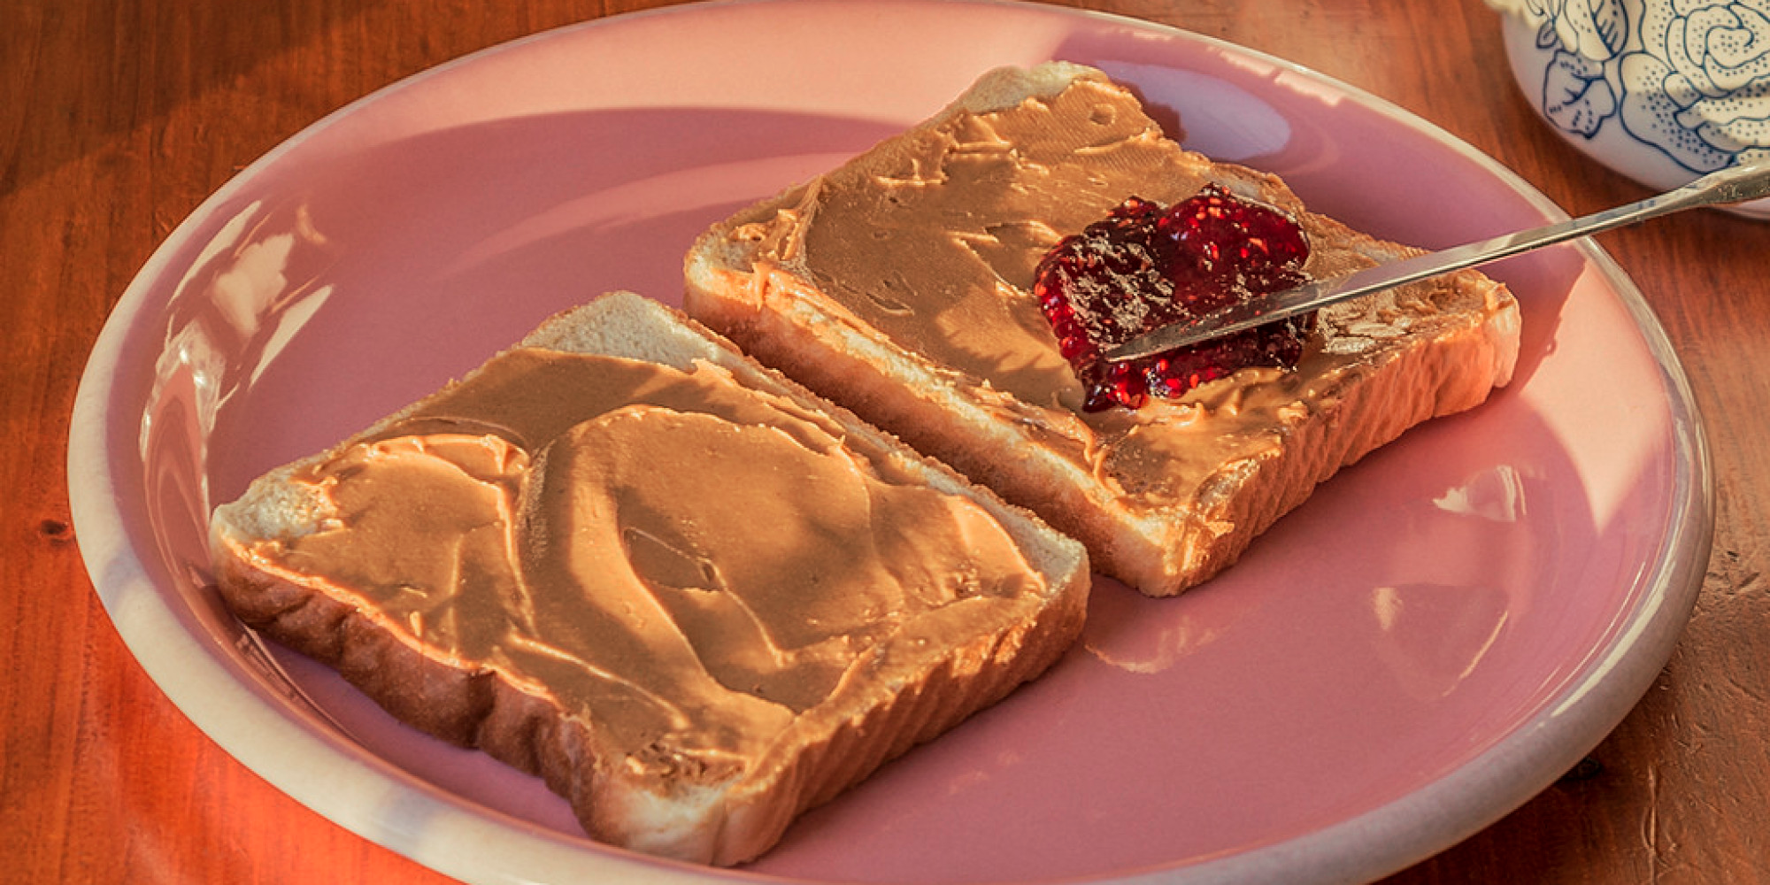
Thinking Like a Programmer:
Programmers have to think a certain way in order to write code that does exactly what we want it to do. Computers and robots may be smart, but only because we teach them to be. For example, if we tell a robot to make a peanut butter and jelly sandwich, it won’t automatically know what to do. We need to instruct it step by step.

Slide 6
Thinking Like a Programmer:
Let’s think about what we have to do in order to make a PB&J sandwich:
We lay out the bread.
But where did we get the bread from? Let’s try that again.
We get the bread from the refrigerator.
How did we get into the refrigerator?
We open the refrigerator.
What naturally comes to us involves a lot of complicated steps for robots. The process of laying out these steps before writing actual code is called writing pseudocode.
}
From here you can see that our digital computers pretty much read things line-by-line.

Slide 7
Thinking Like a Programmer: Exercises
Watch the robot shoot. What are the actions that a robot has to take to shoot a ball? Write pseudocode below.

Slide 8
Congratulations!
You just wrote your first method. Methods are what we call lists of steps in programming. Methods help us make our code easier to write and understand, so that we don’t have to write out all the steps every time we want to do something. We’ll go into further depth about methods next week.

Slide 9
Robot Code
Here’s the real code we used to make the robot shoot the ball. Do you see any similarities to your steps? What does each line do?
Robot.cannon.spinWheels(-v, -v);
if (RobotMap.turningCam == true) {
Robot.cannon.turnCam();
RobotMap.turningCam = false;
}

Slide 10
What if we want to control when the cannon shoots?
Let’s say we only want the cannon to shoot the ball if the cannon is lined up with the goal. That way, the ball will go in every time! In programming, this is a way that we use logic.

Slide 11
How do we use logic in programming?
To program, we will need to think logically. Let’s start with a simple example.
If (3 > 4) {
Print “Math is hard.”
}
Would this piece of code print something? Since 3 is not greater than 4, the code inside the statement wouldn’t run. This process of evaluating if something is true or false is called a conditional.

Slide 12
Conditionals
Let’s look at another example:
If it’s raining, we need an umbrella. Otherwise, we don’t. Makes sense, right? Let’s see what this looks like in pseudocode.
If (raining == true) {
Bring an umbrella
}

Slide 13
Conditionals cont.
When the condition is false, the code will either do nothing, or progress to something called an else statement. Say it’s not raining, so we will wear flip flops.
To add this into our code, we insert “else”:
If (raining == true){
Bring an umbrella
}
Else {
We will wear flip flops
}
The code in the else statement is only executed if the condition in the first statement isn’t true. Otherwise, the code will completely skip the else.
Notes:
Say something about else if, and even if the else if condition is true, the code would not run

Slide 14
Introduction to Booleans
In our pseudocode, we would only do actions if something was true. Whether things are true or false are a big part of logic. Let’s see if the following problems are true or false.
3 > 4
0 == 0
10 > 7
Booleans are things that store a true or false value. Previously, the booleans we used were “raining” and “hungry”.

Slide 15
Conclusions
Here’s what we learned today:
What programming is
How programming is used
How to think like a programmer
How to think logically
Conditionals and booleans
Any Questions?

Slide 16
What’s next:
Our next meeting will be October 11th, right here after SGI.
Next week we’ll begin to go into specific components of programming!
Some things you might be familiar with already (and might not know it) like variables.
Other things might be completely new, like classes and methods, which we’ll go into a lot more depth about.
You can do some research about these if you’d like, but it’s not necessary.
See you guys next week!

